Slide 1
AUA New Faculty Orientation Session
Arina Bekchyan
Hr Director, AUA
Yerevan, August 22, 2016

Slide 2
Employee Benefits
In addition to state-provided benefits according to the RA Labor Law (paid vacation, partially paid sick-leave days)
Health insurance
Tuition remission policy
Opportunity to audit graduate courses
Tuition discounts on Extension courses
http://policies.aua.am/policy/44

Slide 3
Additional Holidays
In addition to the official RA holidays, there are 5 additional paid holidays per year:
Easter Memorial Day
American Independence Day (July 4)
Thanksgiving Holidays (2 days)
Christmas Day (December 25)

Slide 4
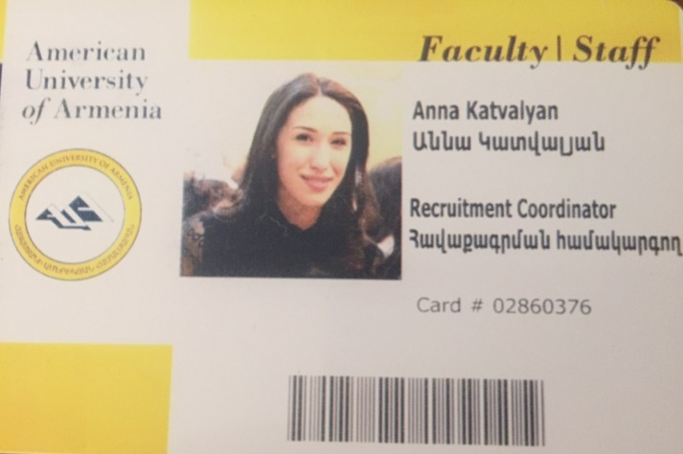
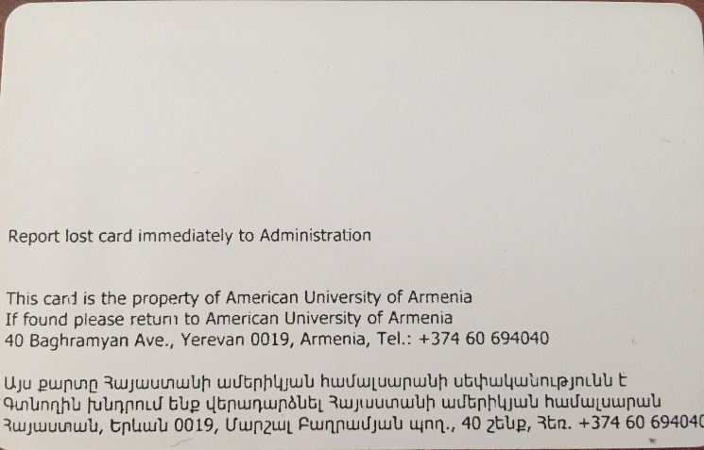
ID Cards
Please send your electronic photo to
Anna Katvalyan
Recruitment and Contract Coordinator at
akatvalyan@aua.am, ext. (25-37)

Slide 5
How to receive your salary
Employment Contracts for Fall Semester 2016
From August 22 to December 20, 2016
Salary are paid on monthly basis –August salary will be paid in the 1st week of September via bank transfer
Please submit you bank account info in AMD
December salary will be paid within 3 working days upon the end of the contracts

Slide 6
General Questions about Contracts
As you know, we need the following documents for contract processing:
Passport (photo and address registration pages) or ID cards (both pages)
Social card
CV
Diploma(s) – (for profession code as required by the RA law)
Bank info – in AMD
You photo– for AUA ID cards

Slide 7
General Questions about Contracts
For non-RA citizens we
will assist in getting a social card and opening a bank account
will give a statement on income tax at the end of employment for tax declaration to avoid double taxation

Slide 8
HR-Specific Policies: Equal Opportunity and Non-discrimination in Employment
No person employed by or seeking employment with the AUA shall be discriminated against because of race, religion, national origin, age, gender, marital status, medical condition or disability

Slide 9
HR-Specific Policies: Business Travel
Please inform HR department about the business trip at a minimum of five days prior by email mentioning the place of the business trip, purpose, duration and expenses
Please submit Business trip request form to HR department for processing

Slide 10
Business trip request form

Slide 11
Thank You!

