Slide 1
Assessment
Feedback
Open Discussion
Timing
Taking PBL to the Next Level
PBL 2.0
American University of Armenia
5 April 2018

Slide 2
Workshop Goals
To discuss our collective challenges and successes to enhance future PBLs
To describe best practices related to PBL, especially in regards to assessment
To incorporate more effective feedback from various sources into our PBLs

Slide 3
GLOW
Write down one positive aspect of a previous PBL – an accomplishment, an “a-ha” moment, realization of deep student learning, etc.
GROW
Write down one negative aspect of a previous PBL – something you want to improve, a source of frustration, etc.

Slide 4
PBL Definition
Project Based Learning is a teaching method in which students gain knowledge and skills by working for an extended period of time to investigate and respond to an engaging and complex question, problem, or challenge
Notes:
“extended period” → beyond just a few weeks… up to a whole semester
“investigate and respond” → sustained student inquiry
“engaging and complex” → challenging, relevant and interesting
Source: Buck Institute of Education
Give Me Shelter, Portland, Maine
https://www.youtube.com/watch?v=4HERh6ZNz5c

Slide 5
DOING PROJECTS
PROJECT BASED LEARNING
Teacher gives directions to students
Teacher asks a question
Students devise their own directions to solve problem
Students learn by following
directions
Students test & revise their own plan
Students apply their knowledge/ skills to solve real-world problems (beyond the class)
Students
present findings
Students gain knowledge & develop skills
Unit ends

Slide 6
Key Components
Project launch
Challenging problem or question
Sustained inquiry
Authenticity
Student voice/choice
Critique and revision
Public Product
Reflection
Notes:
Challenging Problem or Question - The project is framed by a meaningful problem to solve or a question to answer, at the appropriate level of challenge.
Sustained Inquiry - Students engage in a rigorous, extended process of asking questions, finding resources, and applying information.
Authenticity - The project features real-world context, tasks and tools, quality standards, or impact – or speaks to students’ personal concerns, interests, and issues in their lives.
Student Voice & Choice - Students make some decisions about the project, including how they work and what they create.
Critique & Revision - Students give, receive, and use feedback to improve their process and products.
Public Product - Students make their project work public by explaining, displaying and/or presenting it to people beyond the classroom.
Reflection - Students and teachers reflect on learning, the effectiveness of their inquiry and project activities, the quality of student work, obstacles and how to overcome them.

Slide 7
Pitfalls to Avoid
Lack of real-world connection
Focus on products more than process
Not planning learning around targeted standards and skills
Assessing individual learning through group work
Not building a collaborative classroom culture
Notes:
Real-world connection – it can feel contrived and can lose the power to motivate students to engage in deeper learning. Investigation of a local or global issue, connecting to students’ personal interests and concerns. What do you want students to remember in 10 years? Focus on the inquiry driven process and guiding students to ask meaningful questions to investigate compelling real world problems.
Standards-based learning: start with the end in mind – contemplate targeted standards and how connected to real-world learning opportunities. Then identify how students will demonstrate mastery of these skills/knowledge at specified points in the process
Collaborative classroom – idea of belonging is powerful; taking ownership of their learning; building this environment has to be intentional – mini-challenges on what successful teamwork looks like; giving students voice in creating norms for project/class work.

Slide 8
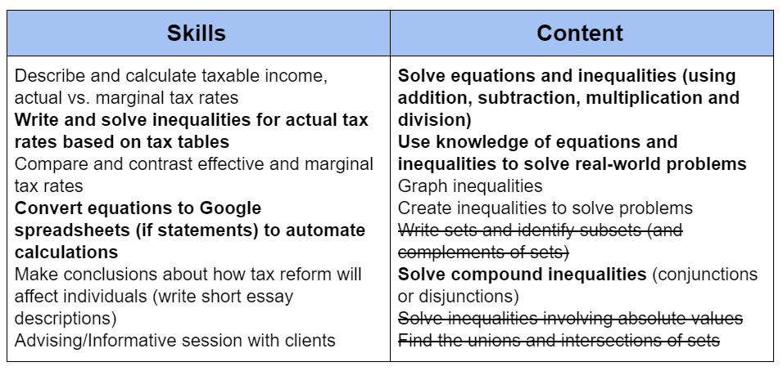
Standards-based planning example
Notes:
Real-world connection – it can feel contrived and can lose the power to motivate students to engage in deeper learning. Investigation of a local or global issue, connecting to students’ personal interests and concerns. What do you want students to remember in 10 years? Focus on the inquiry driven process and guiding students to ask meaningful questions to investigate compelling real world problems.
Standards-based learning: start with the end in mind – contemplate targeted standards and how connected to real-world learning opportunities. Then identify how students will demonstrate mastery of these skills/knowledge at specified points in the process
Collaborative classroom – idea of belonging is powerful; taking ownership of their learning; building this environment has to be intentional – mini-challenges on what successful teamwork looks like; giving students voice in creating norms for project/class work.

Slide 9
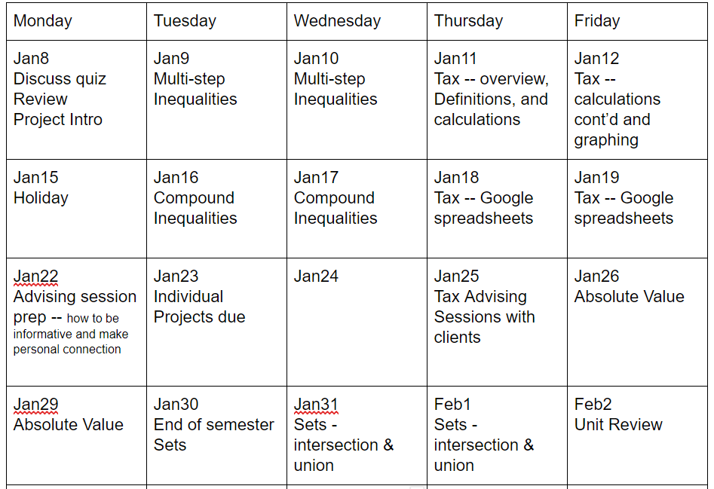
Standards-based planning example
Notes:
Real-world connection – it can feel contrived and can lose the power to motivate students to engage in deeper learning. Investigation of a local or global issue, connecting to students’ personal interests and concerns. What do you want students to remember in 10 years? Focus on the inquiry driven process and guiding students to ask meaningful questions to investigate compelling real world problems.
Standards-based learning: start with the end in mind – contemplate targeted standards and how connected to real-world learning opportunities. Then identify how students will demonstrate mastery of these skills/knowledge at specified points in the process
Collaborative classroom – idea of belonging is powerful; taking ownership of their learning; building this environment has to be intentional – mini-challenges on what successful teamwork looks like; giving students voice in creating norms for project/class work.

Slide 10
Assessment
Notes:
End product is not the only evaluative element. Others are: content mastery, collaboration/participation, presentation, meeting deadlines.
Criteria for success on PBL tasks need to be clearly defined at the start of the project; and should include multiple opportunities for feedback, reflection and time for students to revise their work. Students who have clear criteria for success spend more time discussing and evaluating content, and these conversations increase student learning.
Establish clear benchmarks and due-dates, meet with groups regularly – use planning sheets and group contracts to keep students accountable

Slide 11
Assessment
Map assessments and learning scales for each skill/knowledge criterion to different aspects of the project
How will students demonstrate mastery of targeted knowledge and skills at specific points during the learning process, product development and culminating project presentations
Example: Tax Advising Sessions (Algebra)
Common Core Standard | Project Element #1 (Formative) | Project Element #2 (Summative) | Project Element #3 (Summative)
Solve linear equations and inequalities in one variable. | Team-based problem set | Individual problem set | Explanation of how inequalities can represent tax brackets
Notes:
End product is not the only evaluative element. Others are: content mastery, collaboration/participation, presentation, meeting deadlines.
Criteria for success on PBL tasks need to be clearly defined at the start of the project; and should include multiple opportunities for feedback, reflection and time for students to revise their work. Students who have clear criteria for success spend more time discussing and evaluating content, and these conversations increase student learning.
Feedback and corrections should happen frequently to keep students on track, improve their work and set them up for success in the final product.
(feedback delayed is feedback denied!!!!)
Establish clear benchmarks and due-dates, meet with groups regularly – use planning sheets and group contracts to keep students accountable

Slide 12
Assessment
Rotate among teams to conduct formative and summative assessments while others engaged in project work
Incorporate feedback from: self, peer, teacher, audience
Criteria | 4.0 Exceeds expectations | 3.0 Meets expectations | 2.0 Falls short of expectations
Presentation skills | All of the following elements: Varied eye contact Appropriate body language ….. | Four out of five of the following elements: Varied eye contact Appropriate body language ….. | Three out of five of the following elements: Varied eye contact Appropriate body language …..
Writing conventions
Notes:
100% of reported grade is based on individual achievement on critical learning targets. When combined with audience and peer feedback, this evaluation paints a detailed picture of student achievement in multiple aspects.
More personalized set of lessons to individual students, while getting all students to engage with the outside world.
Self-evaluation: especially important for higher-level thinking and awareness of material, process and final product. It makes students think about their successes, mistakes and goals for next time.
Use peer evaluation to facilitate better collaborative process
Audience feedback – more authentic, provides a wider perspective and may even carry more meaning, especially if content-area experts are involved (adds credibility)

Slide 13
Assessment - individual accountability
Unfair to give one grade when contributions vary
Separate individual assessments from group grades
Biweekly single standard assessment throughout PBL
Individual semester portfolio
Role-based assessment
Weighted scoring
Assign interdependent roles
Develop team goals to depend on growth of each individual’s skills/knowledge
Notes:
Three types of students:
Prefer PBL to traditional learning – it’s more fun and they believe it leads to deeper learning
Looking for path of least resistance – (lazy, apathetic); PBL makes it more difficult for them to hide and be left alone
Traditional is better – motivated by grades; process will distract from overall impact on grade/performance
Portfolio: students must select elements that they were primarily responsible for producing and discuss why they are best examples of each skill. At least two group members must be willing to attest that the element is primarily the work of that student.
Roles (when specific roles are not easily identified): lead or supporting role. They are only graded when in the lead; when in a supporting role, they are graded on their actions to support the team.
Weighted scoring: incorporate self- and peer-evaluations as well as teacher-based informal assessment of team process.
In the end, teams will feel more secure when their individual contributions are recognized and assessed.
Teams can be awarded points based on each member’s meeting or exceeding past performance based on individual assessments.

Slide 14
Timing
Re-work syllabus to focus more on depth instead of breadth
Utilize assessments and incorporate traditional teaching along the way
Notes:
What do you want students to remember 10 years from now?

Slide 15
Feedback -- revision
Schedule interim team/individual project reviews
How are they communicating and collaborating?
If needed, boost collaboration skills – role-playing and team-building
Time management guidance with task organizers
Practice sessions on particular skills – setting them up for success
Emphasis on real inquiry – value questioning, hypothesizing and openness to new ideas and perspectives
Formalize a process for meaningful feedback and revision
Notes:
Feedback and corrections should happen frequently to keep students on track, improve their work and set them up for success in the final product.
(feedback delayed is feedback denied!!!!)
Students need to learn that most people’s first attempts don’t result in high quality and that revision is a frequent feature of real-world work.
In addition to providing direct feedback, coach students in using rubrics or other sets of criteria to critique one another’s work.
Arrange for experts or outside mentors to provide feedback, which is especially meaningful to students because of the source.

Slide 16
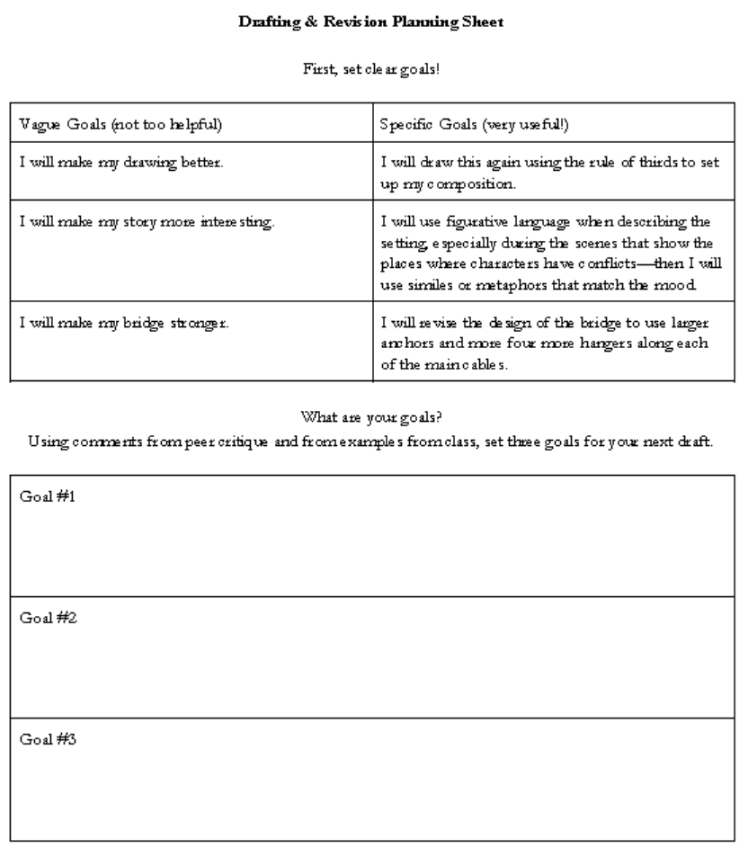
Feedback - revision

Slide 17
Feedback

Slide 18
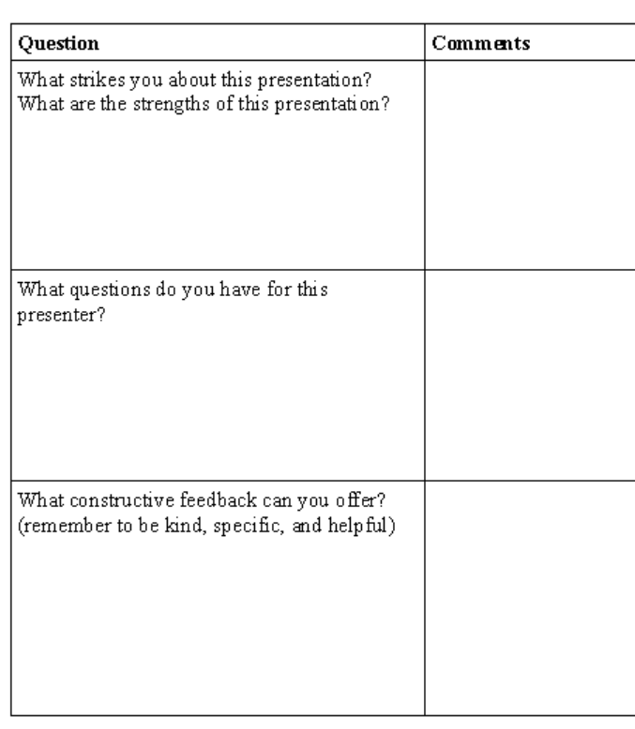
Feedback

Slide 19
Feedback -- critiques

Slide 20
Reflection

Slide 21
Group Work – Building on Bright Spots
Notes:
Success Analysis Protocol

Slide 22
Group Work – Building on Bright Spots
Notes:
Success Analysis Protocol

Slide 23
Group Work – Building on Bright Spots
1. Preparing a case (5 min): Each participant reflects and writes a short case describing one area in which they are finding success with PBL in their courses. Possible questions to explore include:
Is there a moment of specific aspect of the PBL that stands out that you feel proud of? Why?
How did you work as a facilitator or an advisor/coach when you felt most successful?
Why do you feel that this particular PBL was successful?
The case should include specific details concerning the participant’s involvement – what did you do to make it successful? What did you do to engage students in this PBL? It can also account for other factors (conditions, attitudes, collaborations, etc.) that made it a success.
Notes:
Success Analysis Protocol

Slide 24
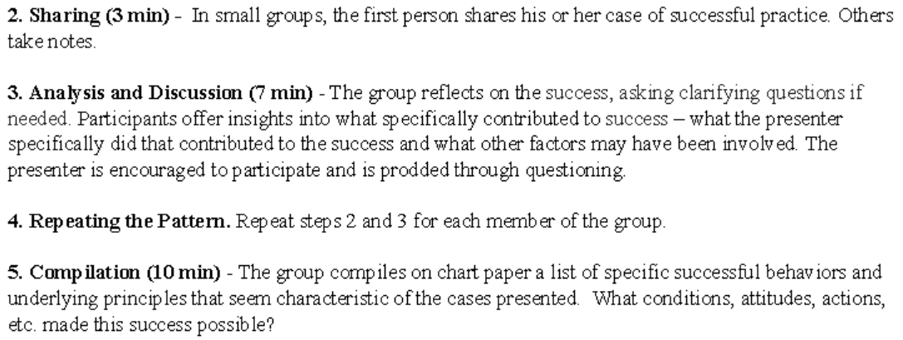
Group Work – Building on Bright Spots
Notes:
Success Analysis Protocol

Slide 25
Successes from Participants
Scaffolding – use of templates
Collaboration
Decision-making
Presentation skills
Critical thinking
Student choice/voice
Authenticity
Engagement/ownership of their own learning

Slide 26
Challenges from Participants
Students not using feedback
Students not evenly sharing workload – accountability
Time limitation – other content to cover
Stakes are high – impact on grades if not pushed by teacher
Less flexible for classroom consumption?
Connecting different ideas developed during classes
Time management – balance of theoretical and practical

