Slide 1
Student Engagement
AUA Faculty Retreat, 23 August 2016
Notes:
We’re all set for the new academic year.
Syllabus with learning objectives – developed or updated? CHECK.
Students enrolled? CHECK
Classroom set-up? CHECK
But, sometimes students can be surrounded by impressive resources and not routinely encounter classes or take part in activities
that engage them in authentic learning.
Especially after the first week of classes and after the initial buzz of excitement…
Students’ reaction and interest wanes; and
Their energy and motivation also falls off.
How can we ensure that our students become and stay engaged?

Slide 2
Session Plan
Overview
AUA Examples
Going Forward
Notes:
Overview – clarify and ensure a common understanding of what is meant by the term ‘student engagement’
AUA Examples – a couple of examples from my classes, one from Tom Samuelian and others from Google survey
End with questions for you to consider as you plan learning activities in your classes going forward (for this semester and semesters to come).

Slide 3
Overview – What is it?
What is it not? If students are not engaged, what are they?
Academic challenge
Active and collaborative learning
Student/faculty interaction
Enriching education experience
Supportive learning environment
Alienated
Inert
Apathetic
Disillusioned
Notes:
Inertia – tendency of matter to retain its state of rest or of uniform motion in a straight line. Prefer inert vs. disengaged because the later suggests an active detachment or separation, whereas the former suggests doing nothing.
Engagement is more than involvement or participation – it requires feelings and sense-making as well as activity.
Not just activities –
think holistically about behavioral, cognitive, and affective factors.
NEED to consider how the engagement activity contributes to learning
Five facets:
Academic challenge – extent to which expectations and assessments challenge students to learn
Active learning – students’ efforts to actively construct their knowledge
Student/staff interactions – level and nature of students’ contact with teaching staff
Enriching educational experiences – participation in broadening educational activities
Supportive learning environment – feelings of legitimacy within university community
Student engagement is based on the assumption that learning is influenced by how an individual participates. In this sense, learning is seen as a ‘joint proposition’ and not a one-way street of “I teach→ You learn”.
Engagement is a coming together, a merging, a fusing. Engagement points to mutual listening, to reciprocity, and dialogue but conducted in a willingness to change. It is the antithesis of separateness, of distance, of incomprehension. Engagement implies not just a coming together but an interaction. – Barnett (2003)

Slide 4
Overview – What does it look like?
Inert Students
Shallow orientation
Memorizing information
Consider study as an external imposition
Disinterested in making connections
Unreflective
Engaged Students
Deep approach to their learning
Relating new material to current knowledge
Intrinsically satisfying relationship to their study
Drawing connections
Examining logic of arguments
Notes:
Teachers sense effective engagement when they succeed in getting students involved in the curriculum. Students feel this when pursuing an activity that they find inherently rewarding.
Typically, we plan activities for students that lead them to specific skills and knowledge.
But this engagement (and the inherent excitement/interest to learn) can and should be a goal in and of itself!
Students with a shallow orientation focus on memorizing information needed for assessments, treat study as an external imposition, do not attempt
to form connections between discrete phenomena, and are unreflective about their study.
Conversely, engaged students are closer to those exhibiting a deep approach to their study by constructing meaning in texts, relating new material to current knowledge, drawing connections with everyday experience and examining the logic of arguments. Independent to the outcomes, it is likely that deep or engaged learners have an intrinsically satisfying relationship to their study.

Slide 5
Overview – Why do it?
Student Success & Development
Student
Engagement
satisfaction
persistence
achievement
All learning and development requires an investment of time and effort by the
student. What students can gain from the variety of events depends on the
amount, scope, and quality of their engagement. As these encounters broaden
and deepen, the student’s capacity for growth is enhanced. (Pace, 1979)
Notes:
What is the key driving factor for student development and success?
Kuh (2003) – what students bring to their higher education or where they study matters less to their success and development than what they are during their time as a student.
This is our ultimate goal, right? Attract/retain students… satisfy and develop them while at AUA… ensure they graduate to become successful and productive citizens.
And many universities use engagement for marketing purposes. An engaging university is a quality university, so it makes sense for universities to use their success at engaging students as a marketing device.
The idea that students must be actively engaged in the learning process in order for it to be effective is not new. This is not just the latest educational buzz word. (show quote)
A diverse body of educational research has shown that academic achievement is positively influenced by the amount of active participation in the learning process.
But, again engagement ≠ participation… participation with a PURPOSE!

Slide 6
Overview – How to do it?
Student Engagement
Staff Engagement
Notes:
Lecturers finding ways to encourage interactions in large classes as well as in small, and encouraging, even requiring, students to study/work in groups, and using feedback to encourage engagement;
Academics finding ways to urge and to stimulate students to work to master thoroughly the material they are studying – to understand fundamental principles, and not simply to memorize the details;
Teachers finding ways that will engage and excite students through connecting their research with their teaching;
Staff taking part in the wider student life of the university, supporting extracurricular activities and so on… this means, of course, that
student engagement requires staff engagement.
Recognize that teaching and teachers are central to engagement — Much research places teachers at the heart of engagement. For example, one study found that “if the teacher is perceived to be approachable, well prepared, and sensitive to student needs, students are committed to work harder, get more out of the session, and are more willing to express their opinion.” (p. 170)

Slide 7
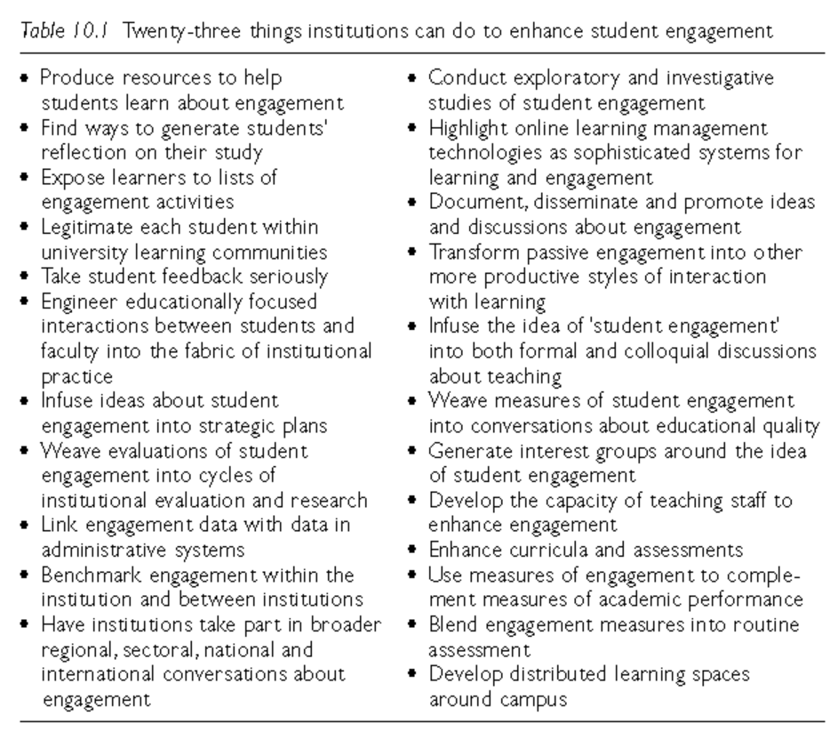
Notes:
Reflection: Seems to be obvious -- having students reflect on their study would play an important role in developing engaged learners. What specifically can we do? Institutions can provide students with advice on becoming more reflective and directed in how they manage their learning. Faculty can weave processes of reflective inquiry into open-ended assessment tasks, possibly by having students document and analyze the strengths and weaknesses of the approaches they have taken. A focus on metacognition can be a foundation for engagement.
Sense of belonging/purpose: Much can also be achieved by the sense of legitimacy that each student feels within the university learning community. Helping students gain a sense of belonging and purpose (more relevant to classrooms) will help them find a place in large and often daunting organizational structures can give each student a sense of purpose, inclusiveness and clarity, and can provide insights into the approaches and outcomes required to become further integrated into academic learning communities. This sense of legitimacy might come through formal induction procedures or ceremonies, through welcome addresses or letters from institutional leaders, or through mentoring partnerships.
Faculty/Student interactions: Engineering educationally focused interactions between students and faculty into the fabric of institutional practice is an important part of engaging students in university learning communities. Time and resources are the challenge for most of us in this regard.
But this is also a challenge from our students’ perspective – they need to balance investments in forming relationships with mentors and advisors with the demands of academic work and other paid employment and family commitments.
The role that such interactions can play in enhancing the quality of education, however, suggests that this is a particularly valuable aspect of engagement and university life to develop.

Slide 8
Notes:
From Hamish Coates,
“Student Engagement in Campus-based and Online Education
(Routledge: New York, 2006)
Discuss engagement: Explicit steps should be taken to infuse the idea of ‘student engagement’ into both formal and colloquial discussions about teaching. Discussions about teaching in departmental seminar series and colloquia should emphasise the value of stimulating engagement.
Curricula and Assessments, which are the explicit and primary focus of learning conversations, must engage students. This need not involve expensive development of faculty skill or learning resources. Simple steps can be taken to enhance the contextual significance of topics,
Ensure that materials provide points of entry for students with different abilities and learning levels;
Use questions to stimulate reflection and debate; and
Apply ideas being learned beyond the classroom.
Providing faculty with an overview of key measurement ideas and approaches can help ensure that questions in assessments are efficient and targeted appropriately, and provide valid and reliable feedback to students. Simple changes which could be easily accommodated into existing practices include the use of student feedback mechanisms and peer review.

Slide 9
Specific tips – in the classroom
Enhance students’ self-belief
Enable students to work autonomously, enjoy learning relationships with others, and feel they are competent to achieve their own objectives
Create learning that is active, collaborative, and fosters learning relationships
Create educational experiences for students that are challenging and enriching and that extend their academic abilities
Notes:
Instructivism (teacher-centric) Sage on the stage
(direct/explicit instruction)
vs. Constructivism (student-centric)
Guide on the side (teacher facilitates)
Does not have to be an either/or decision
Self-belief: Students are engaged when they act as their own learning agents working to achieve goals meaningful to them. They must believe that they can learn, including overcoming and learning from failure. Give students some control over the learning process – builds confidence and commitment to learning.
Autonomous work and work w/ others: related to #1, in that we should try to cultivate intrinsic motivation – fosters self-determination. The more students develop an independent sense of competence, the more motivated/engaged.
Active learning in groups, developing of peer relationships and social skills
Challenging/Enriching – if it’s too easy, they’ll get bored; if it’s too difficult, they’ll get frustrated and give up. Zone of Proximal Development

Slide 10
Specific tips – as an institution
Ensure that institutional cultures are welcoming to students from diverse backgrounds
Invest in a variety of support services
Adapt to changing student expectations
Enable students to become active citizens
Enable students to develop their social and cultural capital
http://www.facultyfocus.com/articles/effective-teaching-strategies/ 10-ways-to-promote-student-engagement/
Notes:
Diversity – To become engaged, students must feel they are accepted and affirmed. Refer to sense of belonging
Support Svcs – wide variety of research confirms the importance of support services and learning/advising centers. Part of the institutional culture, and students engage when that culture values and supports their efforts to learn.
Adapt – we should never be satisfied with how we promote student engagement. As students change and new research/evidence comes up, we should change. Engagement cannot just be promoted, it must also be maintained.
Active Citizens – e.g., Four-day war and students’ role with translations. Great example of engagement and using skills… but need to see that more often!
Social/Cultural capital -- being part of something bigger than themselves. Starts with a sense of belonging, builds through active relationships with others and by knowing how things work

Slide 11
Example from E&C 233: Professional Communication
Program Goal/ SLO | Program Goal 3: Train students for careers and advanced studies in a wide range of English, Public Relations, or Communications fields. SLO 3.2 Tailor communication to, and engage in persuasive communication with, specific audiences and media.
Activity Title | Informational Interviews: Peer Feedback on Emails
Learning Objectives | To write clear and concise emails with an appropriate, professional tone and content. To edit and revise emails and avoid careless errors and typos.
Description | Students worked in pairs with an email sent by another classmate to request an informational interview (names were changed). Students had 20 minutes to prepare edits and then sent me the revised emails. For the next class, I showed side-by-side comparisons of the original and revised emails and students presented their work.
How was it engaging? | Learn from mistakes – act as their own learning agents Sense of intrinsic motivation – ‘real-life’ skill when communicating with professionals from their field of interest Pair work – social learning Reflective

Slide 12
Example from BAB: Econ 121 – Principles of Microeconomics
Program Goal/ SLO | Program-based SLO: Define and describe fundamentals of Accounting, Finance, Economics, Marketing and Communications, Operations, Organizational Behavior and Management, Information Technology, and Quantitative Methods. Course-based SLO: Demonstrate the understanding of the basic concepts and tools of microeconomic analysis and theory.
Activity Title | Card Game: Trading in Financial Markets
Learning Objectives | To understand and appreciate the robustness and efficiency of the textbook model of perfect competition.
Description | 20-minute classroom exercise that resembles trading in the "pit" of some commodities futures markets. Playing cards are used to induce supply and demand functions. After the negotiated prices have stabilized, the participants can be shown market parameters and asked to explain why the prices converged to the observed levels. The objective is to have students discover the supply and demand model themselves, and to realize that "large numbers" of traders are not necessary for obtaining efficient, competitive outcomes.
How was it engaging? | Autonomous learning Pair work – social learning

Slide 13
Example from E&C 231: Public Speaking
Program Goal/ SLO | Program Goal 1: Equip students with knowledge of English as a world language. SLO 1.1 Accurately and precisely communicate– both in speaking and writing - in a variety of contexts and genres.
Activity Title | Jump to Conclusions
Learning Objectives | To conclude speeches ‘with a bang’ – i.e. evoking imagery, using repetition and other delivery techniques to effectively convey a message to an audience
Description | Students worked in pairs to develop the concluding part of a speech. Two teams were given the same topic – e.g., benefits of vegetarianism, effects of climate change, benefits of volunteering. They had part of a class to prepare and then time outside of class. During the next class, the two teams presented and then the audience voted which ending was more effective.
How was it engaging? | Students given some control over learning process – working independently Pair work – social learning Students motivated to succeed Confidence-building through low-risk (ungraded) task

Slide 14
Example from E&C 103: Language & Culture
Program Goal/ SLO | Program Goal 2: Equip student with analytical skills in linguistics, communications and literary criticism. SLO 2.2: Analyze the structure and evolution of English words and texts from the point of view of morphology, phonology, grammar, syntax and semantics. CLO: Perform basic linguistic analysis (phonology, morphology, syntax, pragmatics, etymology)
Activity Title | Formulate Word-Formation Rules
Learning Objectives | Derive a complete and accurate set of rules for set of linguistic data, including regular and irregular forms
Description | Divide into groups of six, each with a designated Moderator and Scribe, spaces to record all group members (collect at the end of class for attendance as well as credit for the assignment) Distribute data sets (for a class of 100, usually 5-6 different worksheets), pre-number worksheets (1 to 16) Flipped Classroom Approach – set timer – 15 mins for completing the assignment. Instructor and TA circulate to check on progress and answer questions (feed forward kinds of responses) As groups complete, record groups who’ve finished (consider prize/recognition for 2-3 early, 100% correct papers to keep on task) check, redirect for further work if needed. When time is up, leave 5-10 mins for one or two groups to report and explain their results
How was it engaging? | Students given some control over learning process – working independently Team work– social learning, learn from each other, some competition among groups Confidence-building through low-risk (ungraded) task – weekly assignment, just have to complete it satisfactorily

Slide 15
Going Forward
How can you challenge yourself and your students to maintain engagement?
How to ensure a good mix of “sage on the stage” and “guide on the side”? The more of the latter, the more engagement!
Keep the discussion open – how to promote more idea exchange among faculty?

