Slide 1
Questioning to Learn
Dr Jacek Brant

Slide 2
"A fool may ask more questions in an hour than a wise man (sic) can answer in a lifetime."
Aristotle
Who might ask questions?
What might be their purpose?
What type of questions are there?
Can a fool ask more questions in an hour than a wise person answer in a lifetime?
Notes:
Students might ask their lecturer questions to clarify meaning.
The focus of my presentation is on the questions that you may ask of your students

Slide 3
Comparing approaches
A narrative and a role-play
How different were the two lessons?
What’s the advantage of each approach?
Which do you consider better and why?
Notes:
Most educators use questioning extensively – both verbally and in writing. Verbal questions are an educator’s ‘stock in trade’
There is a crucial advantage to the questioning approach, and that is that the knowledge gained in such a lesson is 'transferable'. Imagine asking the two classes who experienced these lessons the following question: 'How should bread be stored overnight to prevent it going stale?' The class taught to understand the process of going stale would probably have some correct suggestions; they would be able to transfer their understanding to this unfamiliar problem. It is important to teach for understanding, rather than just for knowing. Questioning teaches students to think for themselves.
Most people would agree that the questioning approach would be more interesting for the students; they are actively involved rather than passively listening, and the questioning style tends to stimulate the students' curiosity - why does cake go stale?
Moreover the students are made to think in the questioning-style lesson; the logic of the subject is exposed and they are encouraged to use it: 'How could we store cakes to stop them going stale?'

Slide 4
Advantages of questioning…
Learning is deeper – focus on understanding
Learning is more ‘transferable’
Feedback is instant on whether learning has taken place
Lecture is more active, intrinsic motivation
Misconceptions are addressed
Encourages the development of high-level thinking

Slide 5
Driving lesson narrative
The key is leading the student through a few steps of thinking so that they understand the right answer

Slide 6
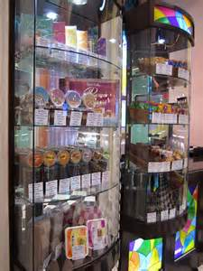
How easy or difficult are the following questions? Why?
How could Grand Candy increase sales of its candy bar?
How should Grand Candy increase sales of its candy bar?
Should the Armenian government restrict the sales of sugary snacks?

Slide 7
Making questions harder…
Is? Was? Did?
Would? Should?
Might?
What? When?
Who?
Why?
How?

Slide 8
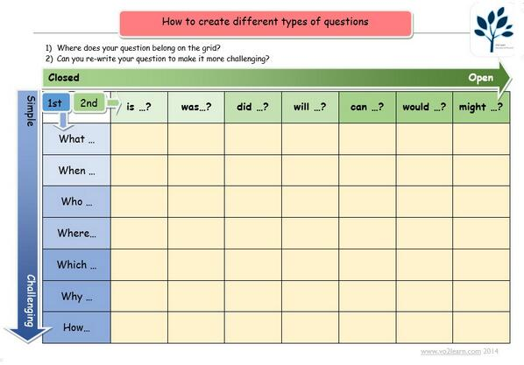
DIFFICULTY INCREASES
Notes:
A tool to help us in constructing questions…

Slide 9
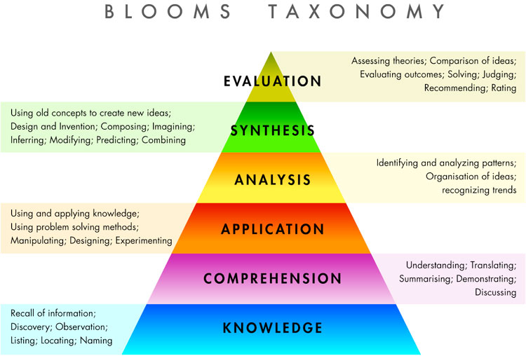
Notes:
Relate the degree of challenge inherent in different questions to Bloom’s taxonomy

Slide 10
Types of question (II)
EXPLORATORY
Tell me a bit more about that…
What do you mean by…?
FOCUSING
How can we break that down?
What evidence can you use to support this?
Which is the most important part of that statement?
SUMMARISING
What I’m hearing is … is this correct?
Notes:
Here’s a different way of thinking about questions – links to zooming in and zooming out (see http://www.learningspy.co.uk/english-gcse/zooming-in-and-out/ )

Slide 11
Classic questioning errors Why is each of these problematic?
Saying a student’s name before asking a question
Relying on ‘hands-up’ answers
Targeting questions at a particular part of the classroom
Asking ‘do you understand’?
Assuming that one correct answer shows that all students understand
Notes:
Participants in pairs or threes discuss different errors and feed back to the group

Slide 12
What questions might you ask?
Armen runs a local butcher’s shop in south-east London. He bought the business from the previous owner using a large bank loan, secured on his house. Although his uncle had offered to lend him the money needed, Armen felt proud that he could raise the finance without relying on family and he was confident that he could make a profit.
Since buying the shop in 2005 Armen has been making a good profit each month, but the difficult financial environment and a changing local community as more health-conscious vegetarians move into the area have hit his sales hard in the last 12 months.
Since April he is having to use some of his savings to pay his regular bills. Things are no longer looking so good.
Notes:
Task for participants: In pairs, list some questions you might ask students to explore this case study
Extension – annotate these to show the purpose of each question / how you’ve structured it to be effective

Slide 13
Final thoughts:
Do you ask questions which students can answer successfully?
Do you leave time for students to think?
Do you use body language (eye contact, smiling etc. to encourage responses?
Do you praise/acknowledge correct responses?
If no answer comes, do you ask a simpler question that leads to the answer to the original question?
Do you make questions short and clear, using straightforward language?
Do you distribute questions widely around the class?

Slide 14
Thank you
Any questions?
Jacek Brant
j.brant@ioe.ac.uk

