Slide 1
Active learning strategies anna gevorgyan anna.gevorgyan@aua.am
January 14, 2022

Slide 3
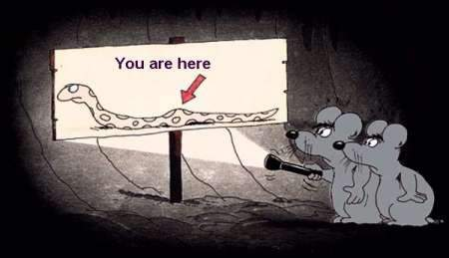
This Photo by Unknown Author is licensed under CC BY-NC-ND
https://humboldt2.instructure.com/courses/27660/pages/intro-to-student-learning-outcomes-slos
Notes:
https://humboldt2.instructure.com/courses/27660/pages/intro-to-student-learning-outcomes-slos

Slide 4
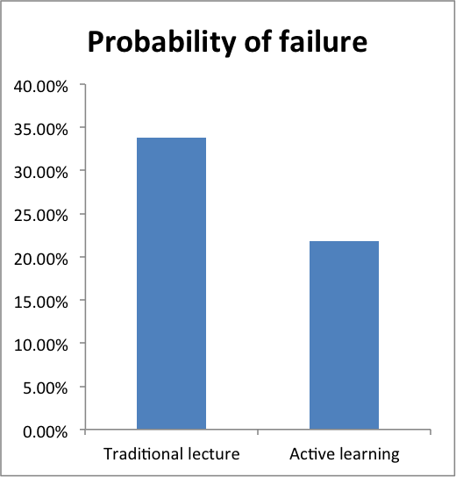
Remember the dancing course…
In a meta-analysis of 225 studies comparing constructivist versus traditional/declarative course design, Freeman and colleagues found that “students in traditional lectures were 1.5 times more likely to fail than students in courses with active learning”
They also found that student performance on exams or other assessments increased when some active learning was included in the course design
Freeman et al., 2014
Notes:
Freeman, S., Eddy, S.L., McDonough, M., Smith, M.K., Okoroafor, N., Jordt, H., and Wenderoth, M.P. (2014). Active learning increases student performance in science, engineering, and mathematics. Proceedings of the National Academy of Sciences USA 111, 8410-8415.

Slide 5
Active learning…
… instructional activities that require students to do meaningful learning activities and think about what they are doing.
…approaches that promote active learning often explicitly ask students to make connections between new information and their current mental models, extending their understanding.
https://cft.vanderbilt.edu/guides-sub-pages/active-learning/#evidence
Prince, 2004

Slide 6
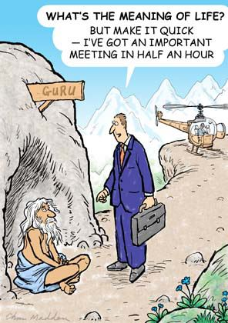
At the core - what is uniquely human about human development
MEANING
INTERACTION
MEDIATION

Slide 7
Meaning, meaning

Slide 8
I am going to the bank!

Slide 9
https://legacy.lessonstream.com/lessons/
Images, by Keddie

Slide 10
Schema(ta) – in-the-head knowledge

Slide 11
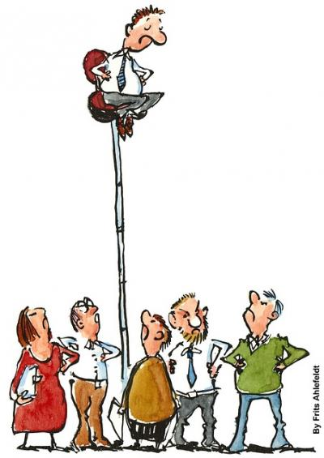
So, Meaning…
Learning happening between individuals through meaningful interactions
Learning should be based on contexts and not be taught through isolated items
This Photo by Unknown Author is licensed under CC BY-SA-NC

Slide 12
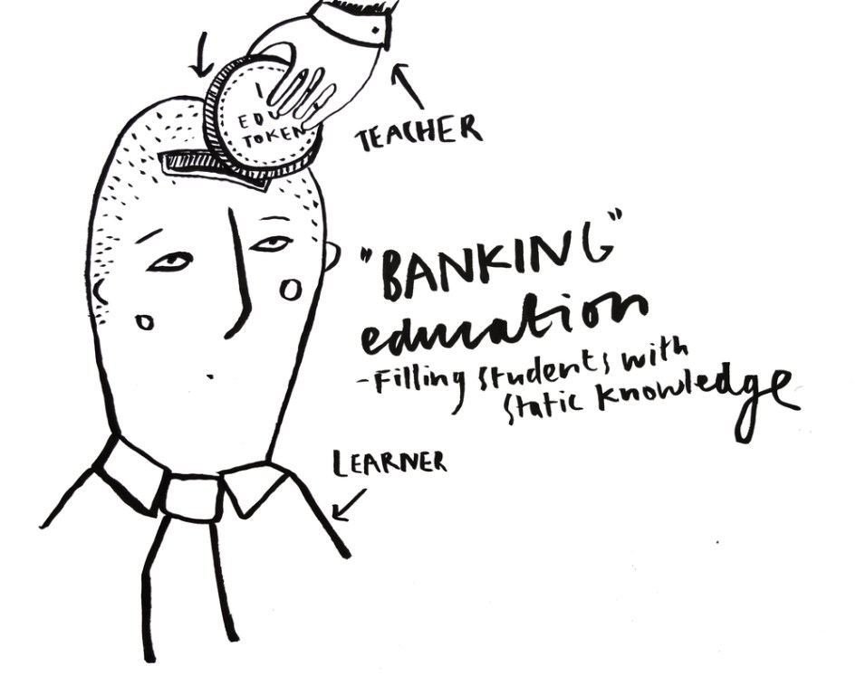
Mediation
This Photo by Unknown Author is licensed under CC BY

Slide 13
Zone of proximal development (ZPD)
Learning occurs in the learner’s ZPD
For learning to happen the T needs to scaffold/guide the SS from “cannot do” to can do independently w/o help

Slide 14
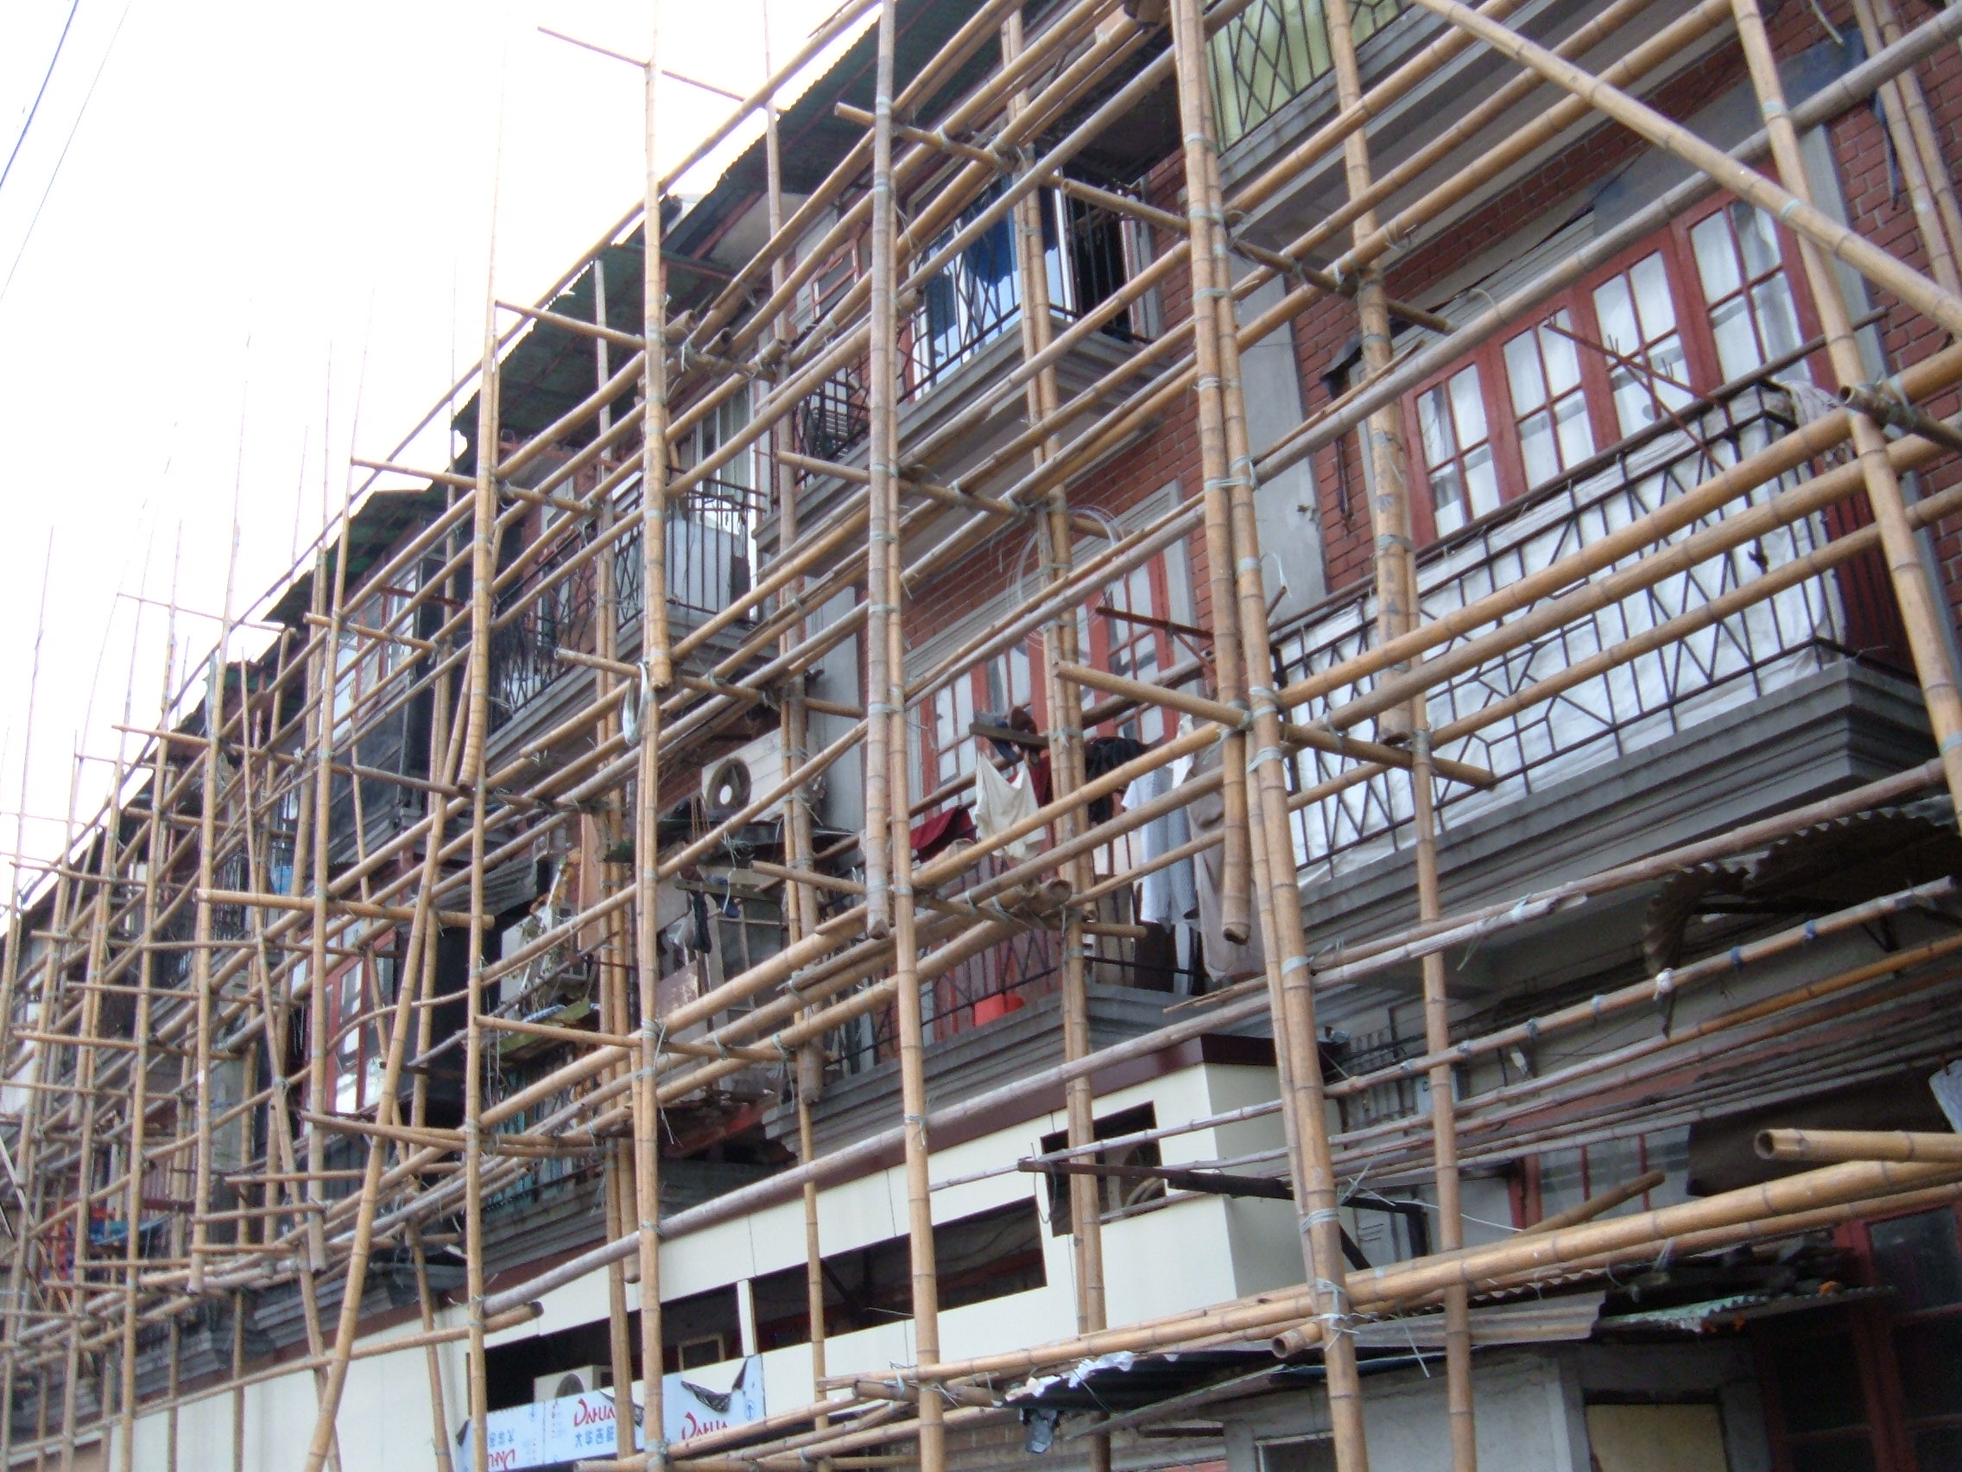

Slide 15
Scaffolding: “temporary, but essential support to learners to carry out the tasks successfully so that the learner will later be able to complete a similar task alone”

Slide 16
This Photo by Unknown Author is licensed under CC BY

Slide 17
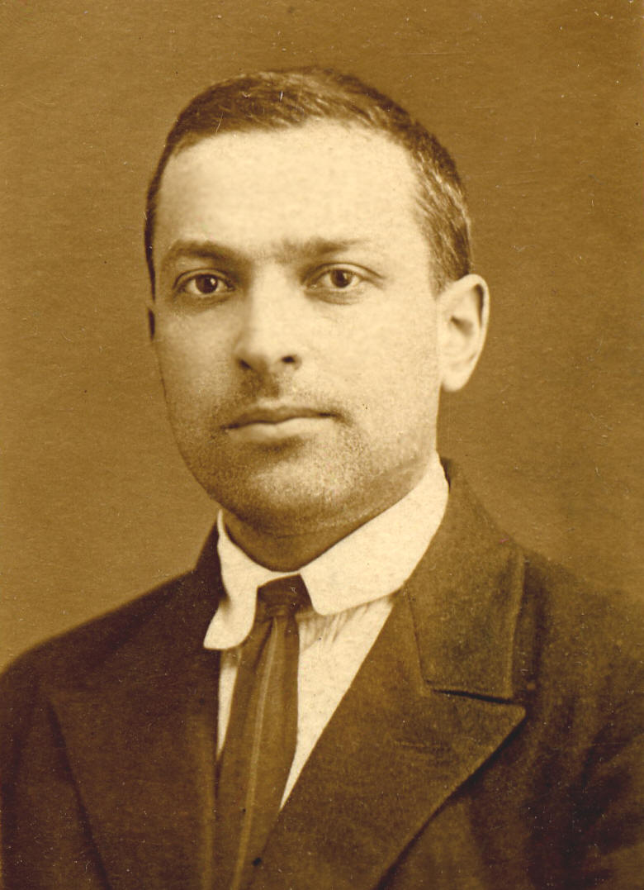
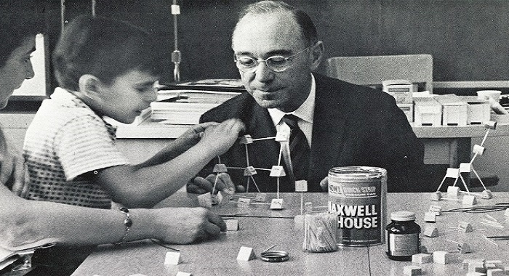
“Scaffolding”
Jerome Bruner
Lev Vygotsky

Slide 19
Examples of scaffolds
Breaking task into smaller parts
Modelling
Graphic organizers, Templates, Flow charts, Outlines showing content organization.
Concept maps or mind maps that illustrate relationships.
Cue cards or question cards to facilitate discussion.
Examples - Samples, specimens, illustrations, problems: Real objects; illustrative problems used to represent something, sample problems to practice important concepts.
Question Cards - Prepared cards with content- and task-specific questions given to individuals or groups of students to ask each other pertinent questions about a particular topic or content area.
Shell questions- Incomplete sentences which students complete
Visual Scaffolds - Pointing (call attention to an object); representational gestures (holding curved hands apart to illustrate roundness; moving rigid hands diagonally upward to illustrate steps or process), diagrams such as charts and graphs; methods of highlighting visual information
https://citt.ufl.edu/resources/assessing-student-learning/scaffolding/

Slide 20
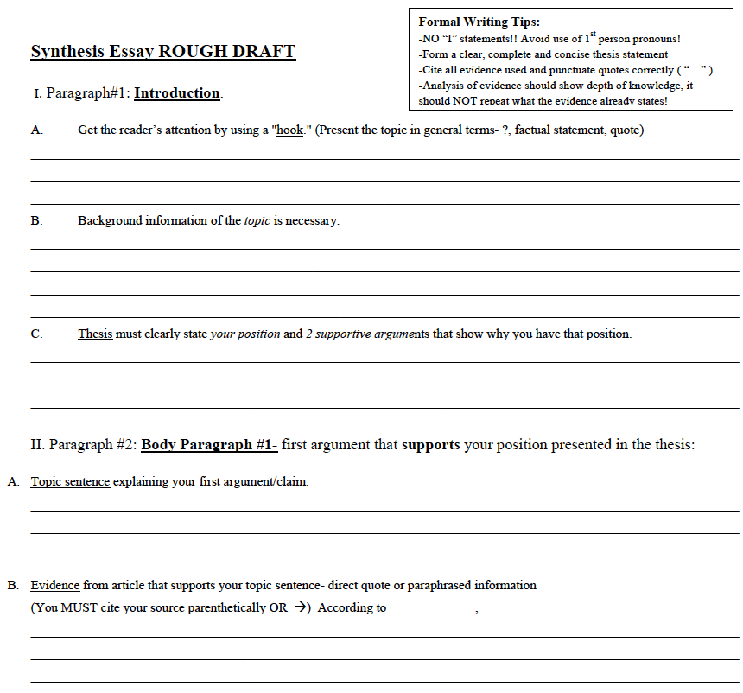
Examples of scaffolds

Slide 22
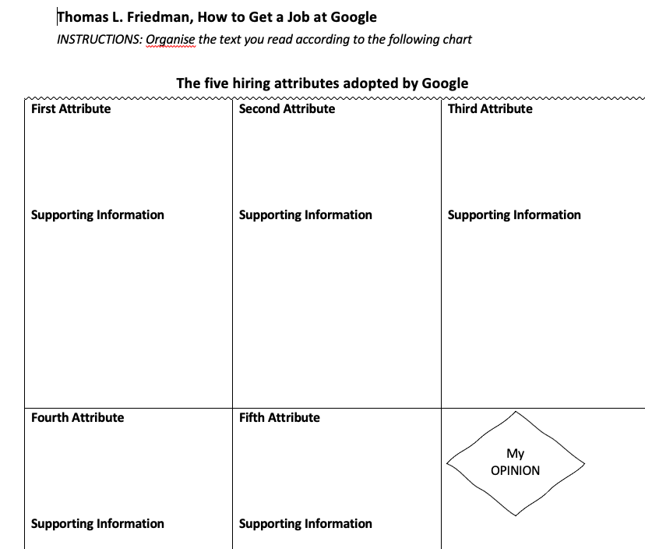

Slide 23
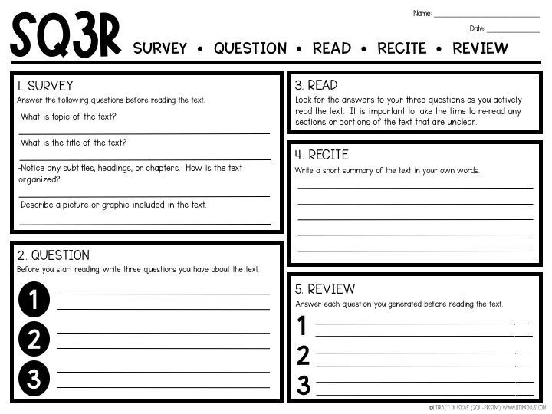

Slide 24
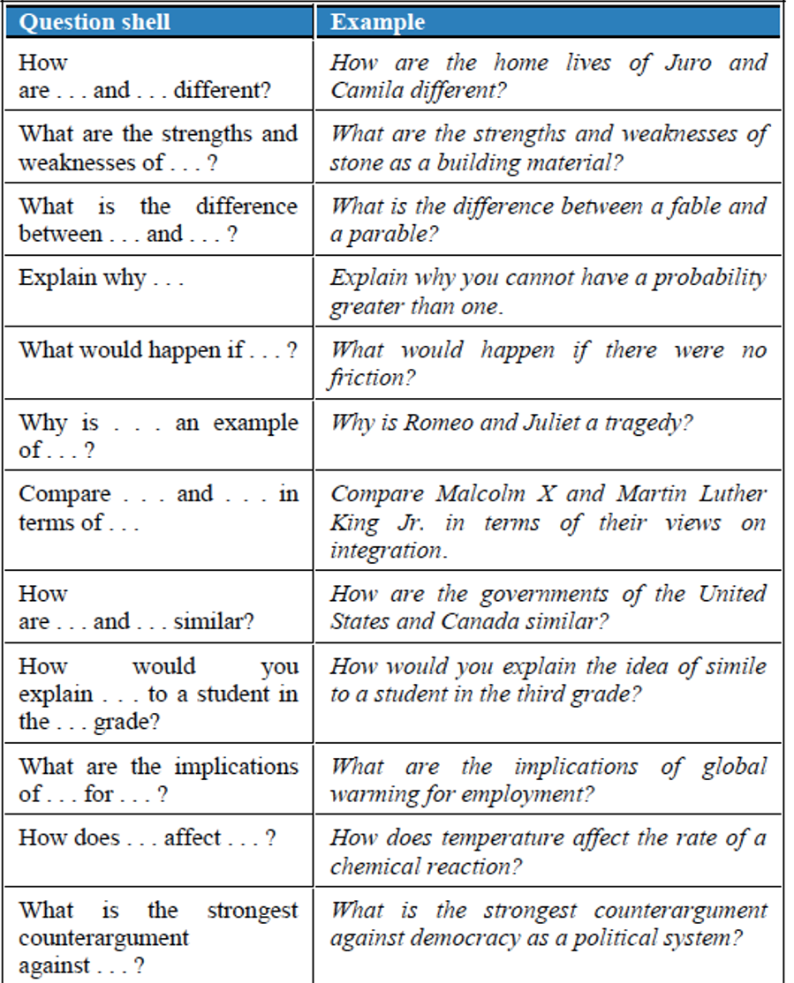

Slide 25
“Current pedagogical and neurocognitive theories propose that multisensory input, compared with unisensory input, is beneficial for learning outcomes,” i.e. Learning a new word in multiple ways makes the learning more durable.
https://link.springer.com/article/10.1007/s10648-020-09527-z

Slide 26
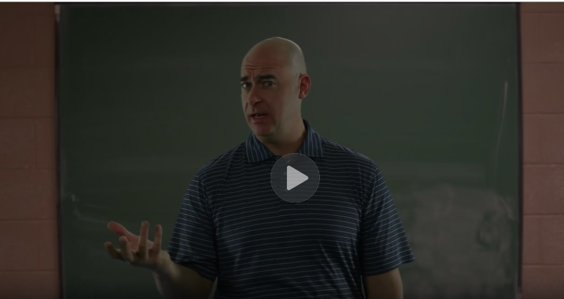
Three Teachers: Guided Practice
The video is accessible here https://www.coursera.org/learn/lesson-design/lecture/dHi91/video-2-three-teachers-guided-practice

Slide 27
Interaction: Group work

Slide 28
In planning a collaborative task you need to decide on the following:
The types of interactions you will have with your students
The types of interactions your students will have with one another
The tasks and materials you will select
The role expectations and responsibilities you will assign

Slide 29
Effective group work…
Has clear instructions
Requires a clear outcome for the task
Is built around a task within students’ ZPD
Involves ALL participants and ideally has a role for all to play
Has well-calculated timing for completing the task
Supposes that students know how to work in groups

Slide 30
Techniques, tricks and tips

Slide 31
Lecturing Interactively. Additional ideas
The Pause Procedure
Pause for two minutes every 12 to 18 minutes, encouraging students to discuss and rework notes in pairs. This approach encourages students to consider their understanding of the lecture material, including its organization.
Demonstrations
Ask students to predict the result of a demonstration, briefly discussing with a neighbor. After demonstration, ask them to discuss the observed result and how it may have differed from their prediction; follow up with instructor explanation.
Think-pair-share—Ask students a question that requires higher order thinking (e.g., application, analysis, or evaluation levels within Bloom’s taxonomy). Ask students to think or write about an answer for one minute, then turn to a peer to discuss their responses for two minutes. Ask groups to share responses and follow up with instructor explanation.
Student-generated questions
Provide students with a copy of your learning goals for a particular unit and a figure summarizing Bloom’s taxonomy (with representative verbs associated with each category). Challenge groups of students to create (test) questions corresponding to your learning goals and different levels of the taxonomy. Consider having each group share their favorite test question with the whole class or consider distributing all student-generated questions to the class as a study guide.
http://www.buffalo.edu/ubcei/enhance/designing/learning-activities/active-learning/active-learning-techniques.html

Slide 32
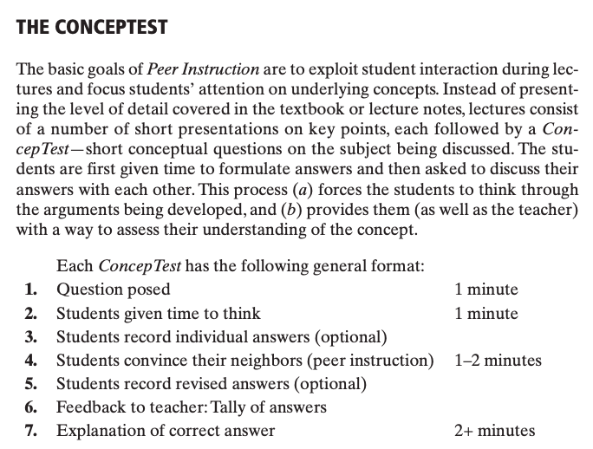
Eric Mazur, lecturing interactively

Slide 33
Eric Mazur, lecturing interactively
A demo of Mazur’s use of ConcepTests can be viewed here: https://www.youtube.com/watch?v=wont2v_LZ1E

Slide 34
Concept maps

Slide 35
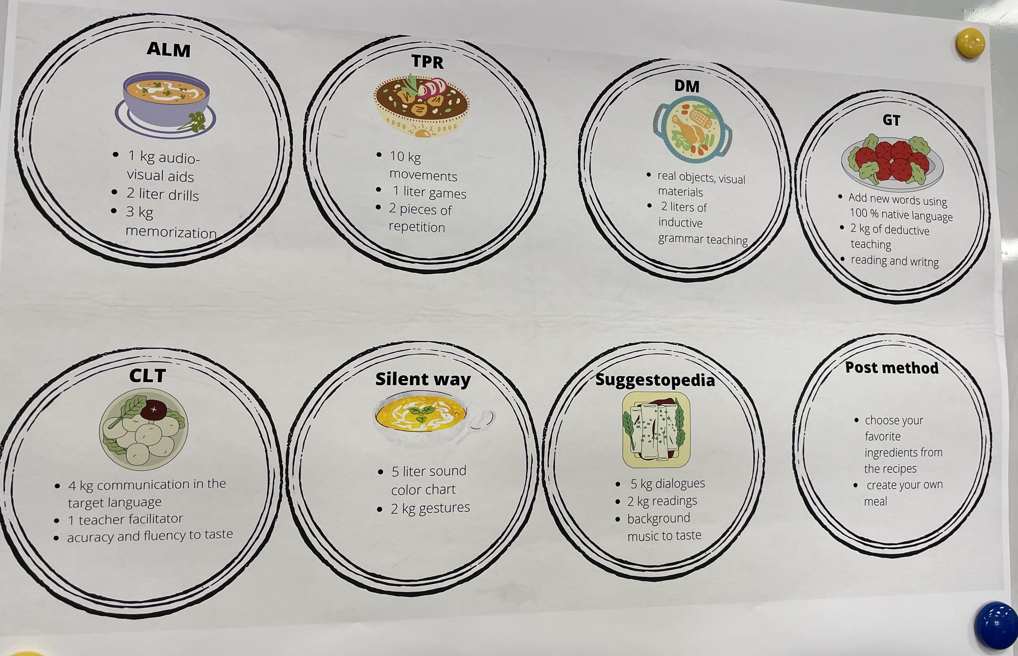

Slide 36
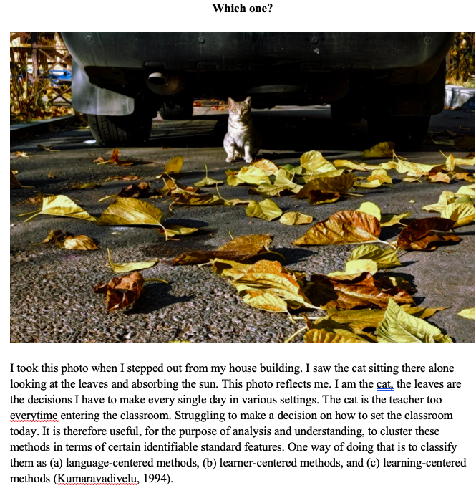
Digital essay Using photovoice

Slide 37
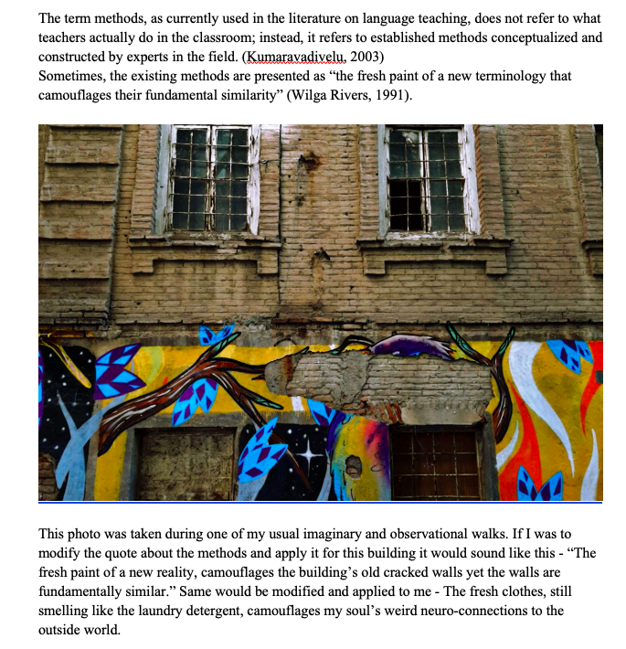
Digital essay Using photovoice

Slide 38
Misc. Activities: DeBono’s hats
White Hat: The data. Facts or missing facts.
Red Hat: Emotion. Feeling. Opinion
Yellow Hat: Benefits, Good points. What you like about it.
Black Hat: Bad points. Problems. Mistakes you can find.
Green Hat: Creativity. Do something differently. What if it was another way?
Blue Hat: Conclusions. The main idea. The Most valuable information.
https://www.debono.com/

Slide 39
When Thinking about SLOs…
What do we know about it? Data, facts… | What do we feel about it? | What are the positive aspects of it? | What are the negative aspects? | What are alternative ways about implementing it? | How do we summarise what we know about it

Slide 40
Getting to know each other
Pick 3-4 paper clips. Based on the color that you chose, share with your partner the following:
Yellow stands for interesting facts about yourself (e.g. your name origin, lifetime moments, travel stories, etc)
Red stands for qualities and skills you’d like to develop or improve during your studies
Pink represents qualities a good teacher you’ve had possesses
White represents your hobbies (or anything you do for fun)
Green stands for an embarrassing moment(s) in classroom or life
Blue represents your favorite foods or drinks

Slide 41
Minute paper or quick write
Interest:
*Without looking at your notes, what was most memorable or stands out in your mind about today’s class? *What was the most surprising and/or unexpected idea expressed in today’s discussion?
Relevance:
*In your opinion, what was the most useful idea discussed in today’s class? *During today’s class, what idea(s) struck you as things you could or should put into practice?
Attitudes/Opinions:
*Would you agree or disagree with this statement: . . .? Why? *What was the most persuasive or convincing argument (or counterargument) that you heard expressed in today’s discussion?
Analysis:
*What did you perceive to be the major purpose or objective of today’s class?
Conceptual Connections:
*What relationship did you see between today’s topic and other topics previously covered in this course? *What was discussed in class today that seemed to connect with what you are learning or have learned in other course(s)?
For more see: https://oncourseworkshop.com/self-awareness/one-minute-paper/

Slide 42
Pecha kucha 20 min 20 slides
https://flickriver.com/

Slide 43
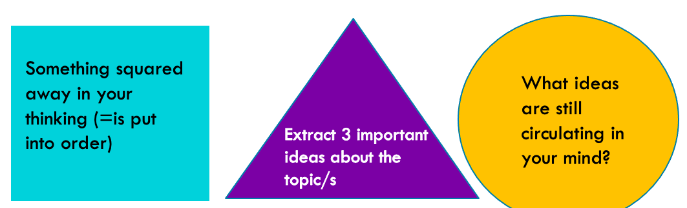
More ideas
Role Plays: e.g. Interview with the originator of the teaching method
Speed dating: e.g. syllabus speed dating
3-2-1: describe 3 main ideas, 2 concepts you can teach others, 1 question you still have

Slide 44
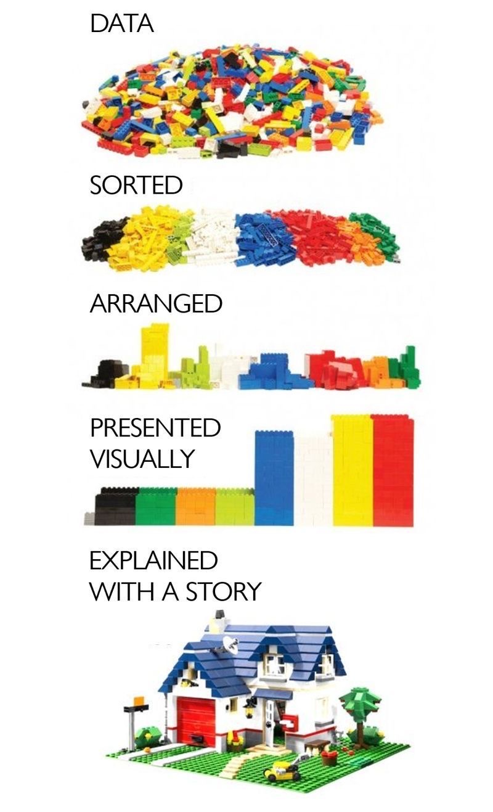
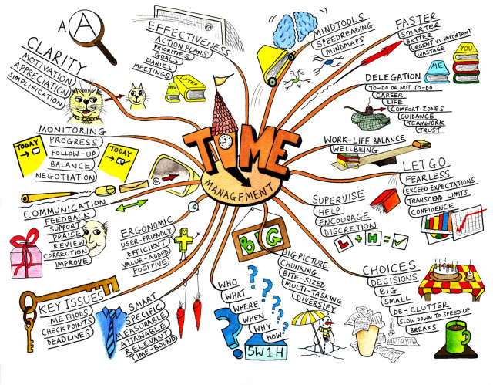
Wrapping up…

Slide 45
More ideas
Active learning strategies:
https://cetl.uconn.edu/active-learning-strategies/
https://documents.uow.edu.au/content/groups/public/@web/@dvce/documents/doc/uow222256.pdf
https://omerad.msu.edu/teaching/teaching-strategies/active-learning-strategies
https://www.usf.edu/atle/documents/handout-interactive-techniques.pdf
https://documents.uow.edu.au/content/groups/public/@web/@dvce/documents/doc/uow222256.pdf
Collection of Web 2.0 Tools for Classroom Activities http://www.livebinders.com/play/play?id=333286

Slide 46
Helpful Resources and links
Case-based collaborative learning: Using cases in teaching, structuring case discussion, channeling expertise among students, debriefing case: https://instructionalmoves.gse.harvard.edu/cbcl
• Simulation: simulation design, preparing students, giving peer feedback, synthesizing simulation through lecture, contextualizing learning with guest speaker: https://instructionalmoves.gse.harvard.edu/simulations
• Project-based learning: designing authentic projects, scaffolding tracking the learning process, presenting projects: https://instructionalmoves.gse.harvard.edu/project-based-learning
• Team-based learning: supporting team-building, assessment of collaborative work:
https://instructionalmoves.gse.harvard.edu/team-based-learning

